Slide 1
Node.js 14.15 => 18.4
By Naor Tedgi (Abu Emma)
@ntedgi

Slide 2
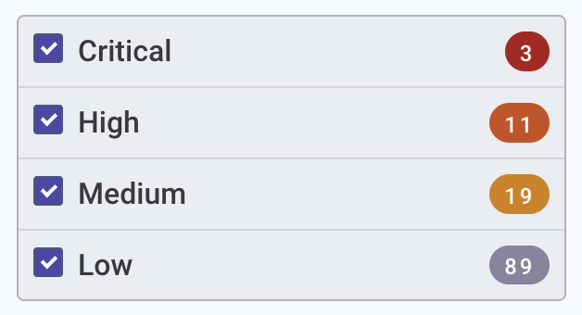
Motivation:
Our current image node:14.15.1-slim has 122 Vulnerabilities
Related to node
https://snyk.io/test/docker/node%3A14.15.1-slim

Slide 3
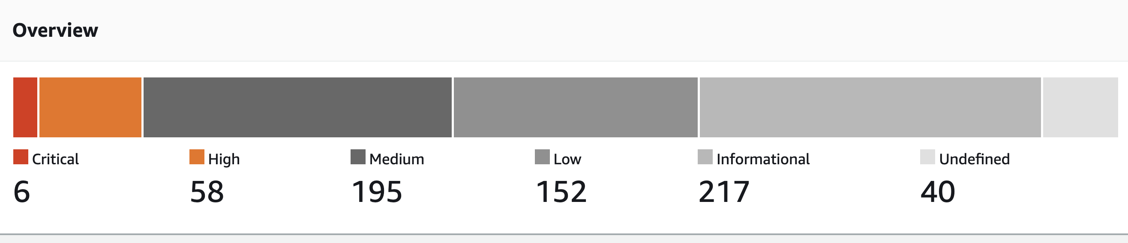
Motivation:
node:14.15.1-slim use linux distro:5.4.0-1049-aws
Which has 662 Vulnerabilities
https://eu-west-1.console.aws.amazon.com/ecr/repositories/private/032106861074/platformjs/image/sha256:fe984047d33fa58ac6373ba68df6693d9553810008facf412f776a96d8ad7e6f/scan-results/?region=eu-west-1

Slide 4
So… What’s New??
New Trends in JS world
V8 Engine Optimizations
Language fatures
Cool Kids Syntax
Other stuff

Slide 5
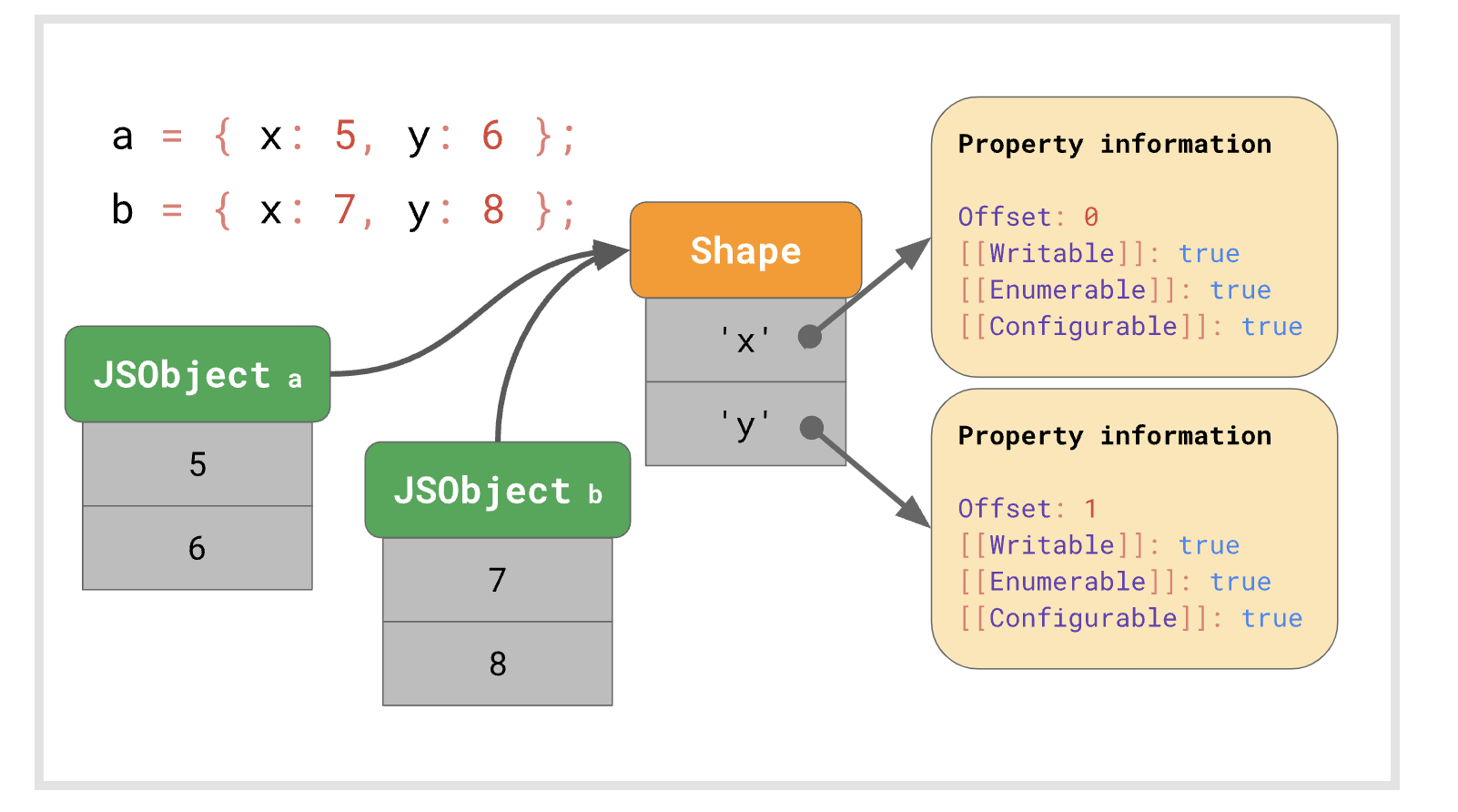
Super fast super property access Performance improvement in both class fields and private class methods.
V8 Engine Features

Slide 6
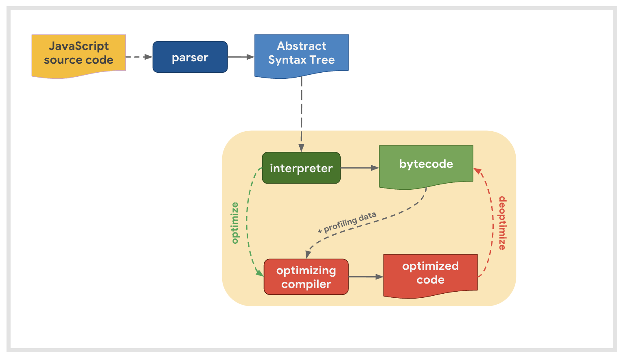
Super fast super property access Performance improvement in both class fields and private class methods.
V8 Engine Features

Slide 7
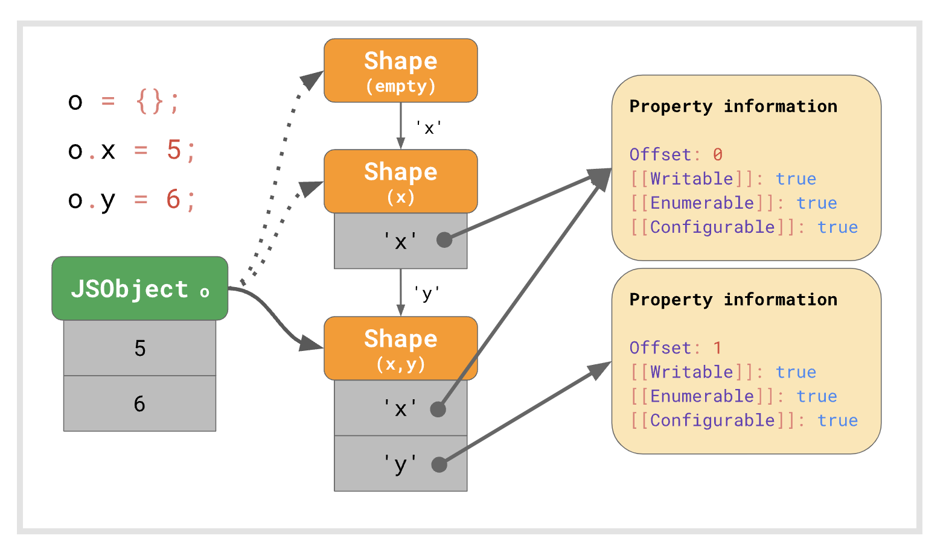
Super fast super property access
V8 Engine Features

Slide 8
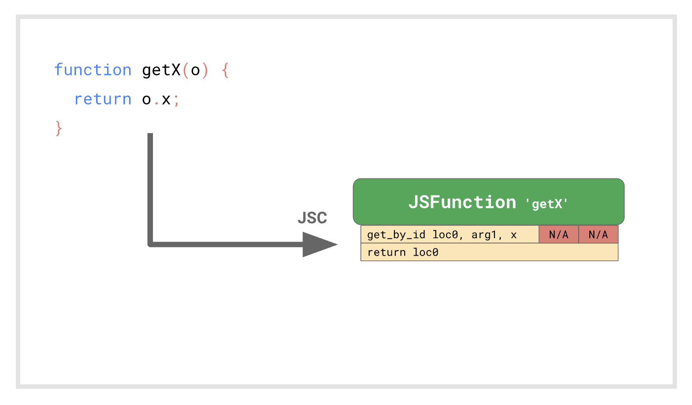
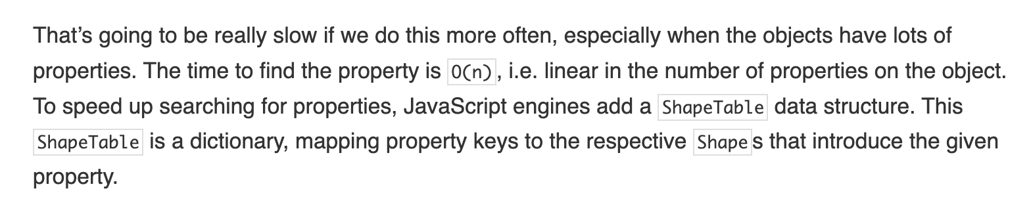
Super fast super property access
V8 Engine Features
https://mathiasbynens.be/notes/shapes-ics

Slide 9
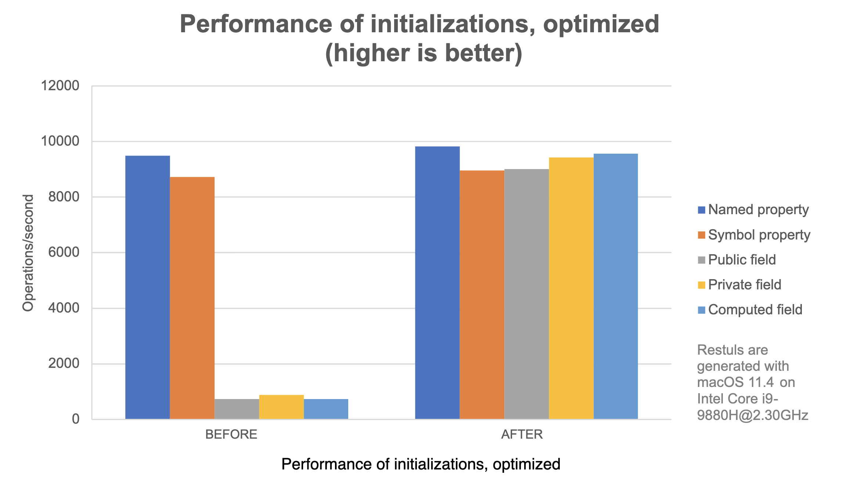
Super fast super property access
V8 Engine Features
https://mathiasbynens.be/notes/shapes-ics

Slide 10
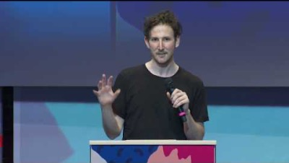
Node 14.18 – Built-in tooling
10 Things I Regret About Node.js - Ryan Dahl -JSConf EU

Slide 11
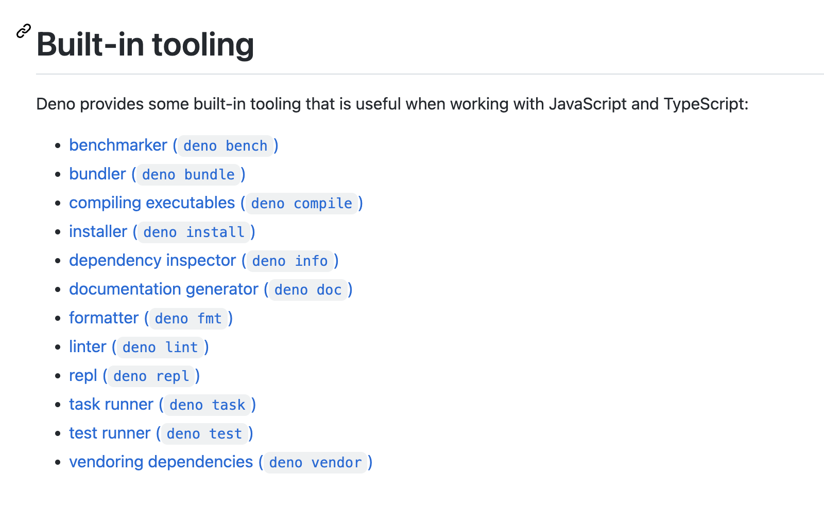
Node 14.18 – Built-in tooling
fmt (eslint,prittier) , task (grunt) test )mocha ,jest …(

Slide 12
New import protocol
For example:
node:util/types
node:string_decoder
node:assert
node:test ! (will talk more about later)

Slide 13
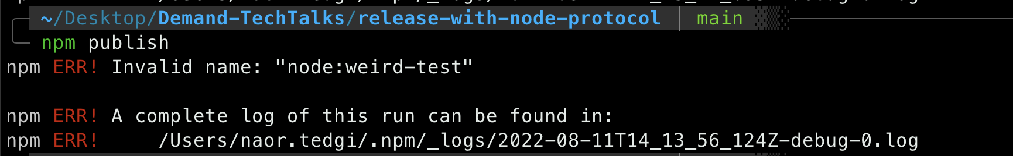
New import protocol
function isCorrectlyEncodedName (spec) {
return !spec.match(/[/s+%:]/) &&
spec === encodeURIComponent(spec)
}

Slide 14
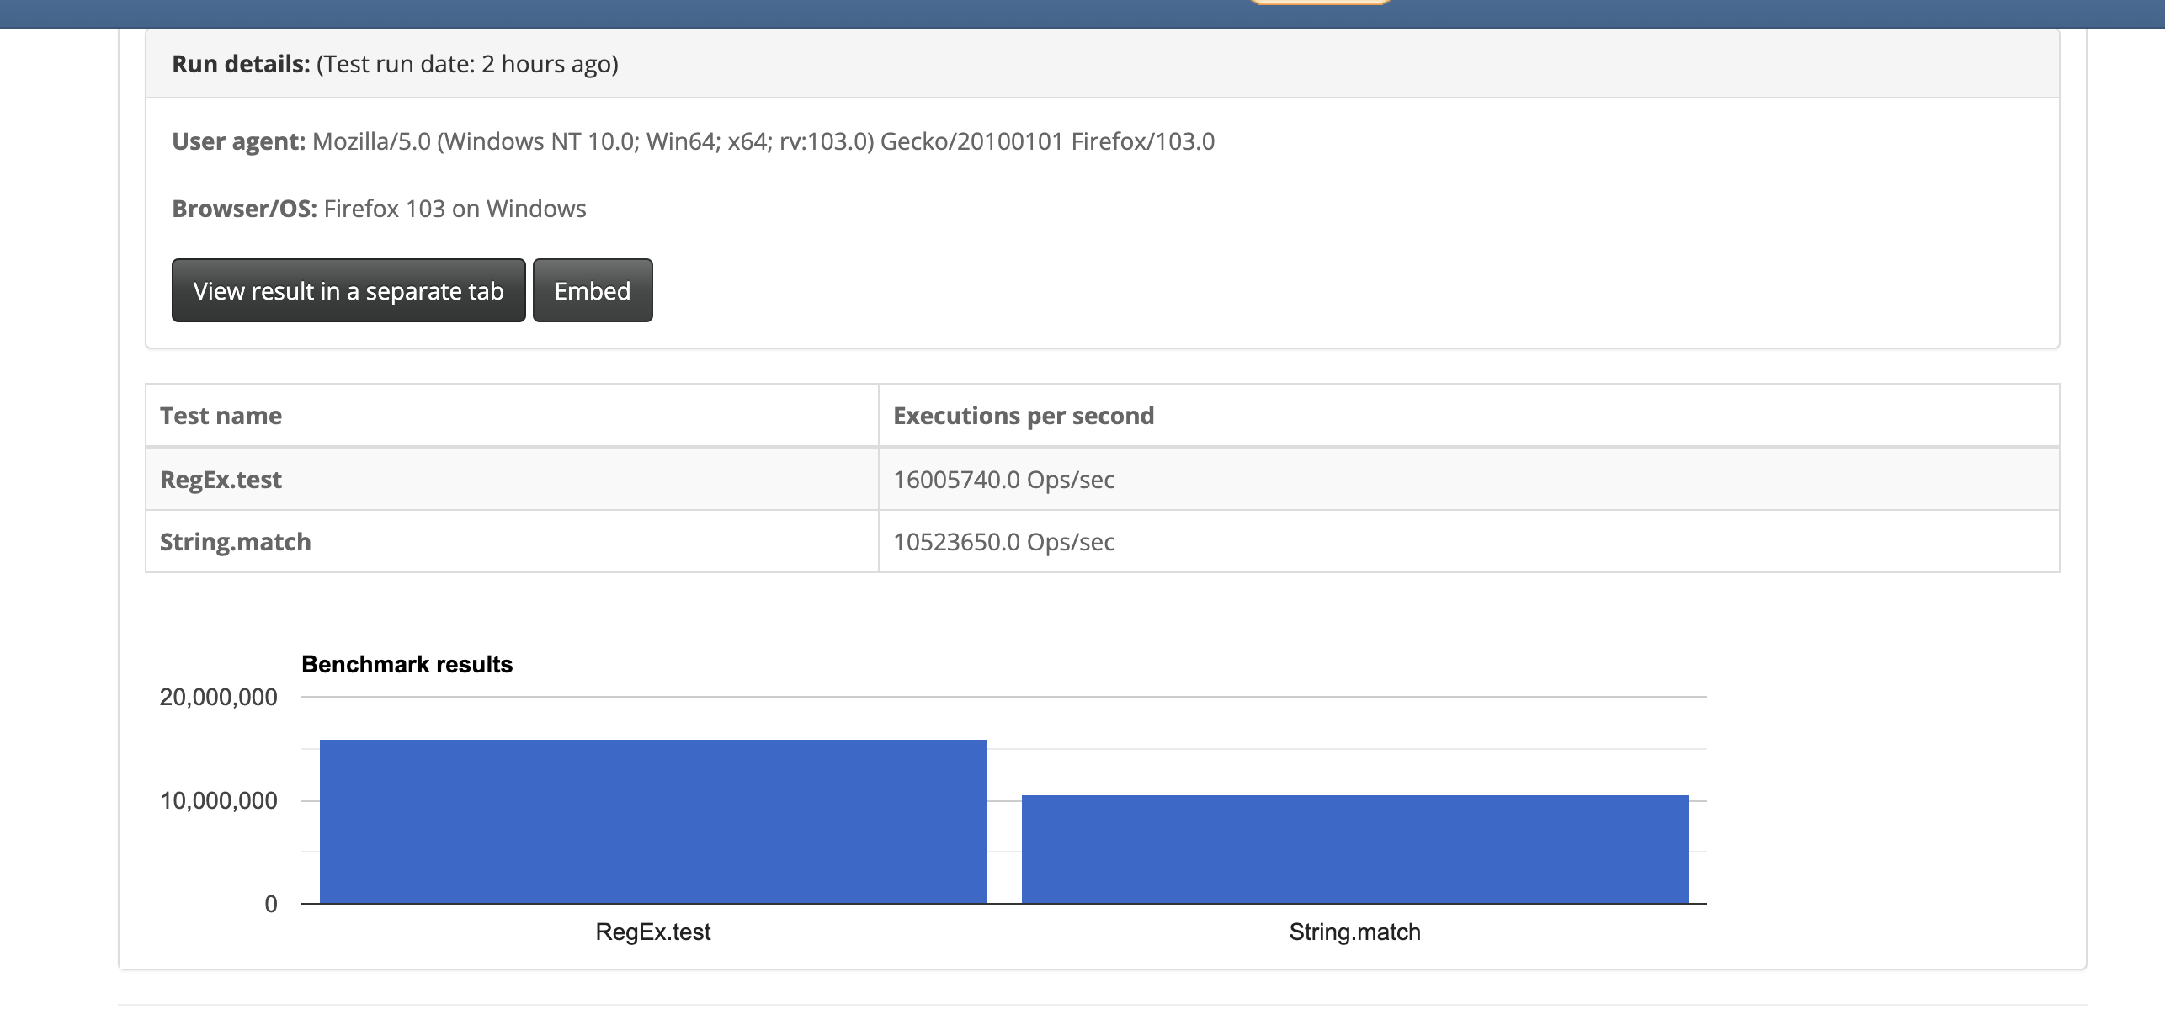
New import protocol

Slide 15
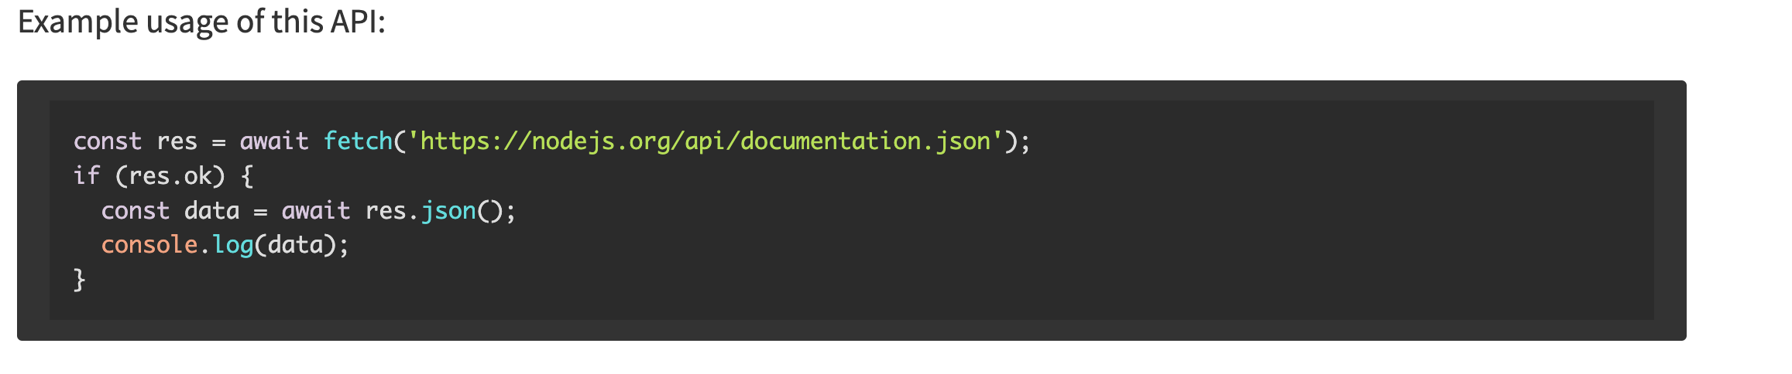
Features: fetch
Globalley avaliavle no need to import nothing .
based upon undici-fetch
Through this addition, the following globals are made available: fetch, FormData, Headers, Request, Response.

Slide 16
Features: fetch
Today at platform js were using 2 different liberies for http-clients.
"got": "^11.8.3", "request": "^2.78.0", (inside demand-client!)

Slide 17
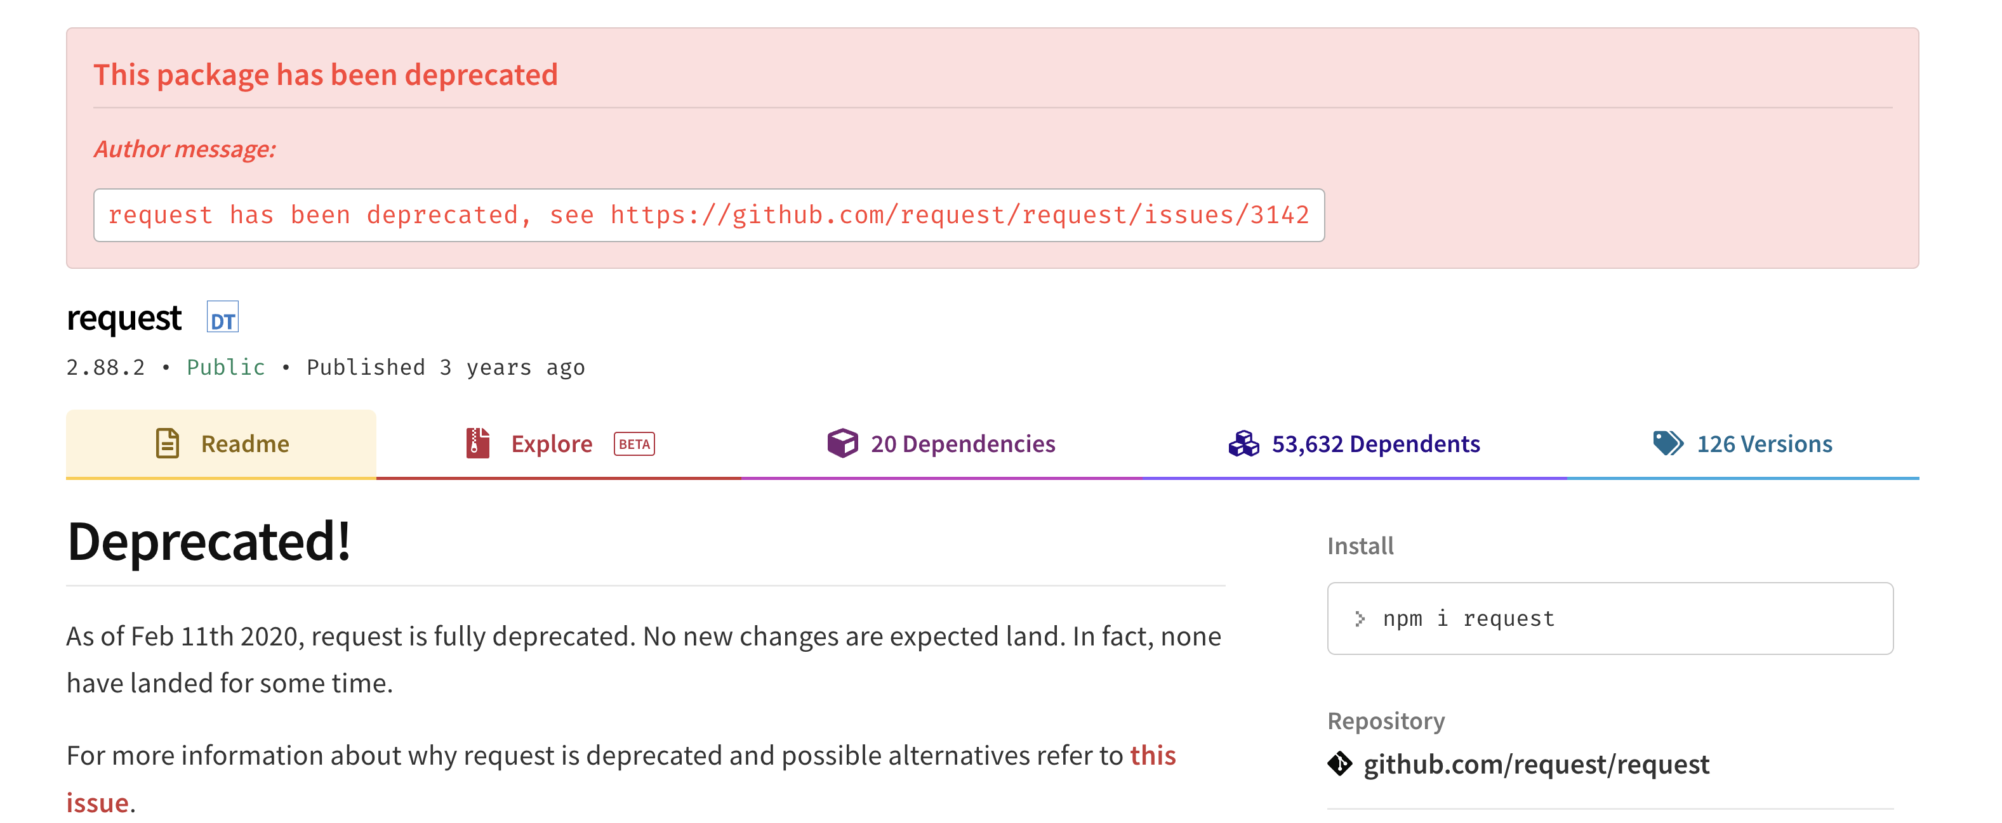
Features: fetch

Slide 18
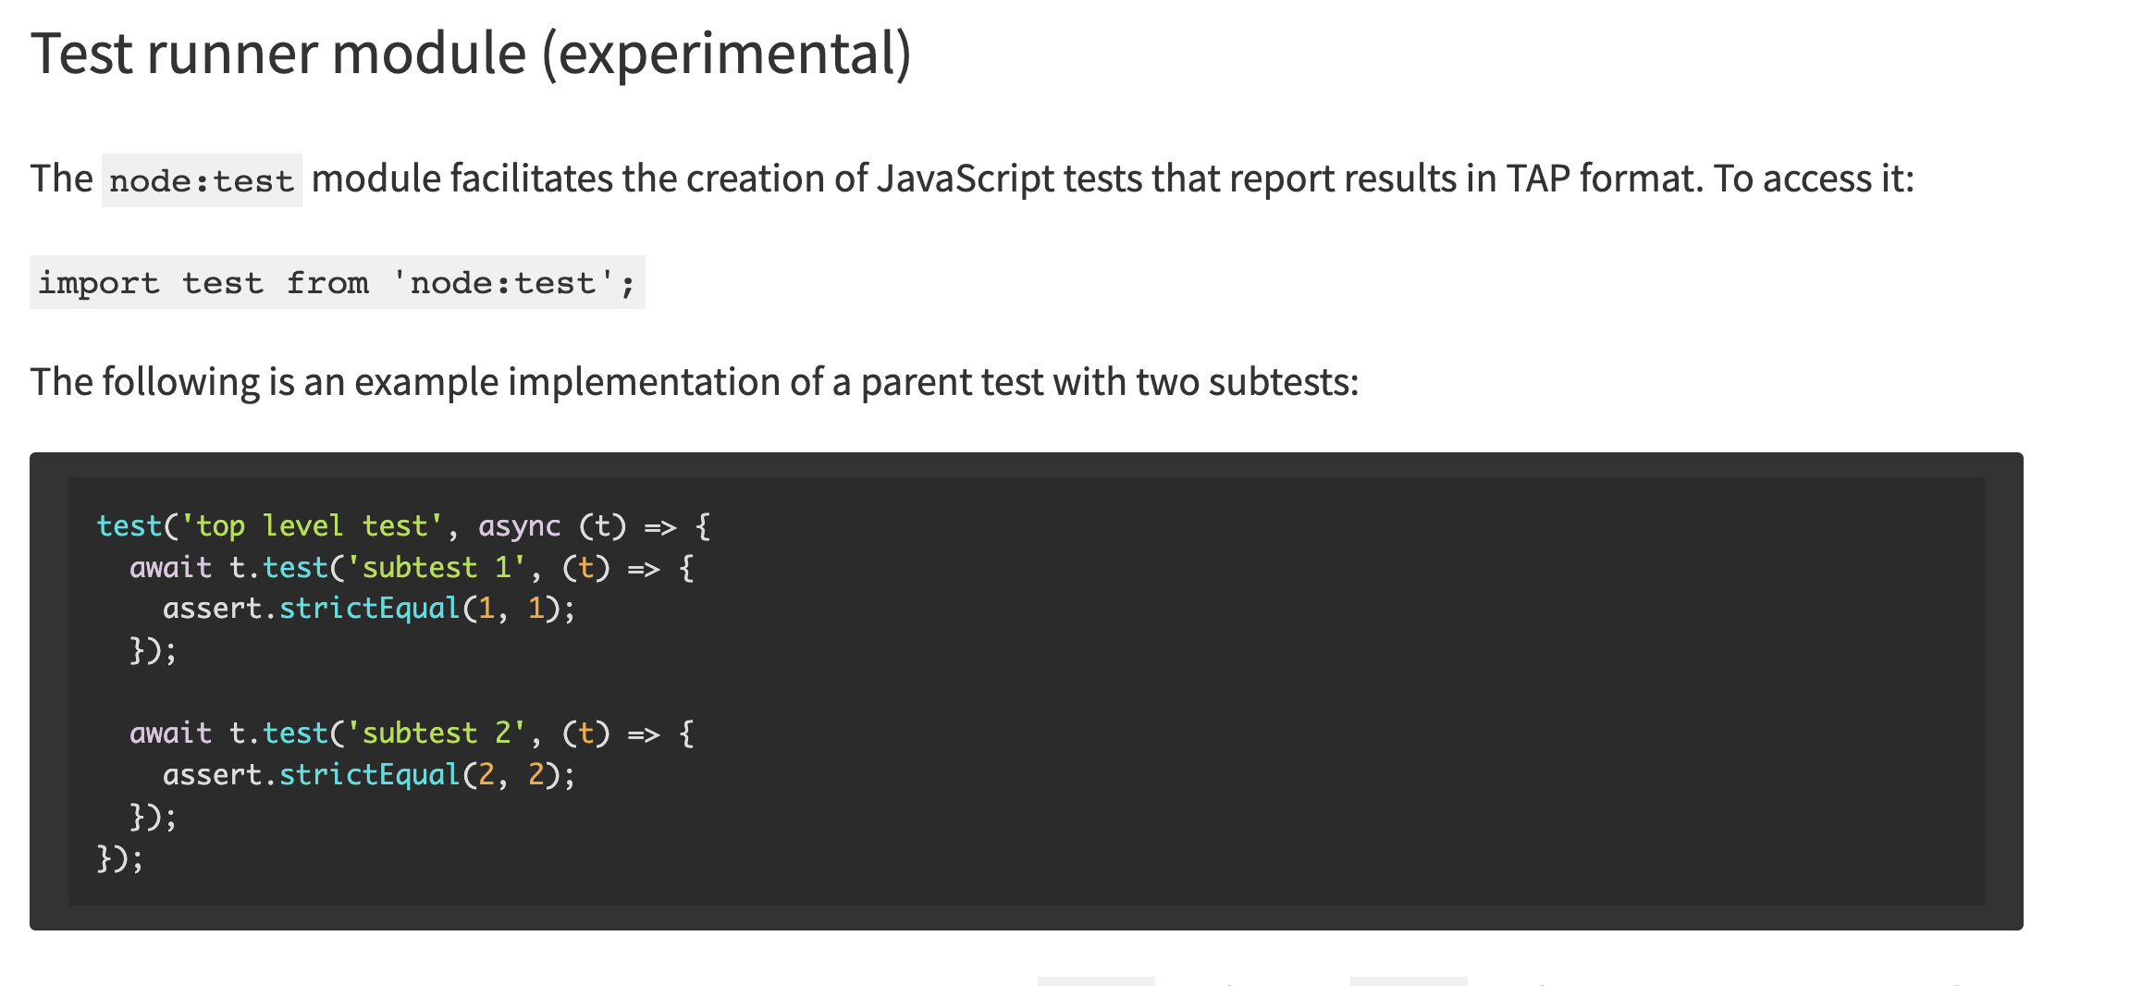
Features: ’node:test’
based upon node-tap
Note: (coverage,reports everything inside..)

Slide 19
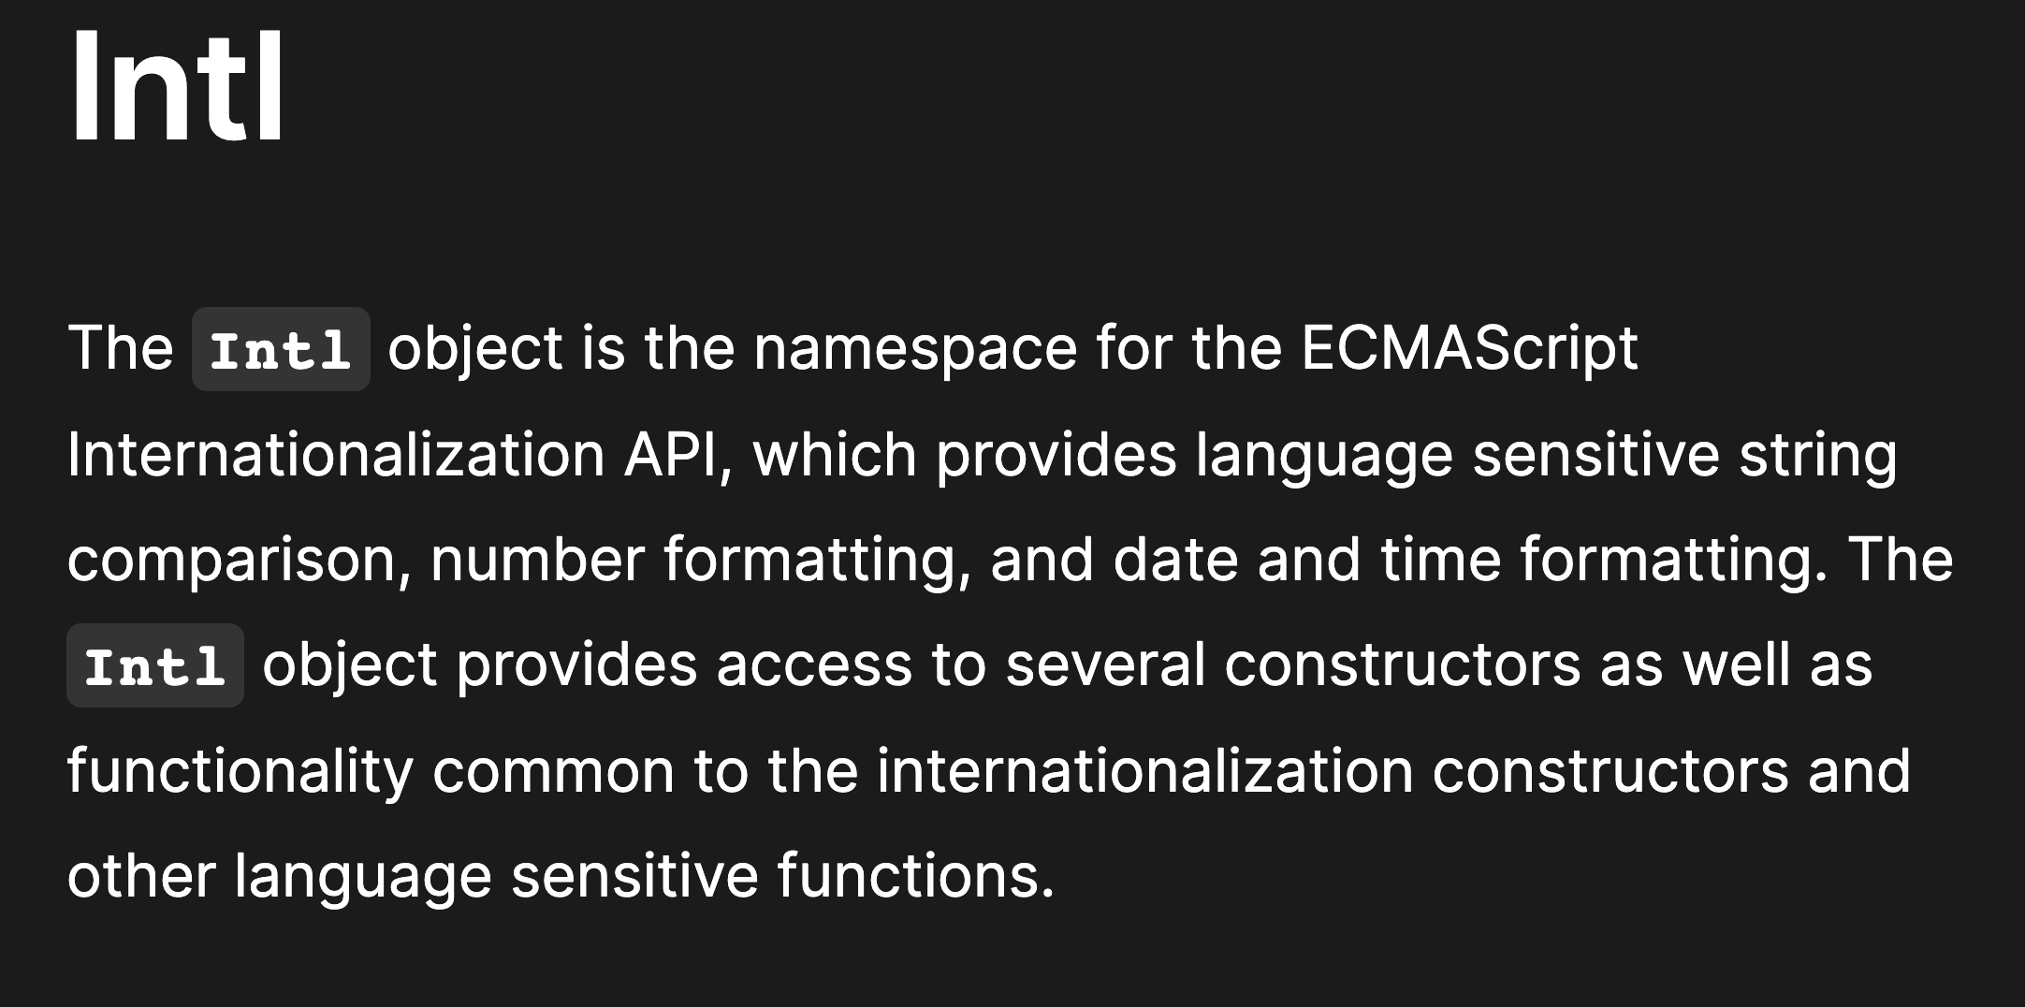
Features: intl additions

Slide 20
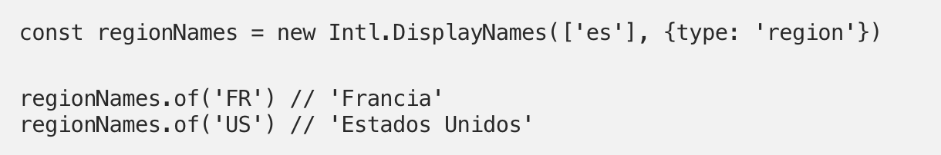
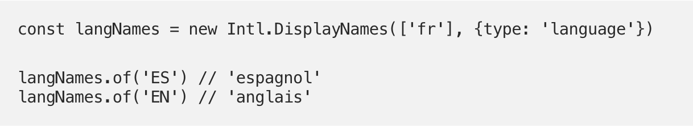
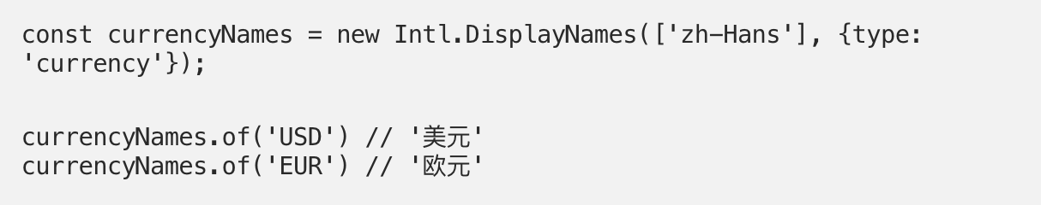
Features: intl additions

Slide 21
Features: intl additions
if ( [ "Asia/Anadyr", "Asia/Barnaul", "Asia/Chita", "Asia/Irkutsk", "Asia/Kamchatka", "Asia/Khandyga", "Asia/Krasnoyarsk", "Asia/Magadan", "Asia/Novokuznetsk", "Asia/Novosibirsk", "Asia/Omsk", "Asia/Sakhalin", "Asia/Srednekolymsk", "Asia/Tomsk", "Asia/Ust-Nera", "Asia/Vladivostok", "Asia/Yakutsk", "Asia/Yekaterinburg", "Europe/Astrakhan", "Europe/Kaliningrad", "Europe/Kirov", "Europe/Moscow", "Europe/Samara", "Europe/Saratov", "Europe/Simferopol", "Europe/Ulyanovsk", "Europe/Volgograd", "W-SU" ].indexOf(
new Intl.DateTimeFormat().resolvedOptions().timeZone) === -1 ) { return; }
new Intl.DateTimeFormat().resolvedOptions().timeZone

Slide 22
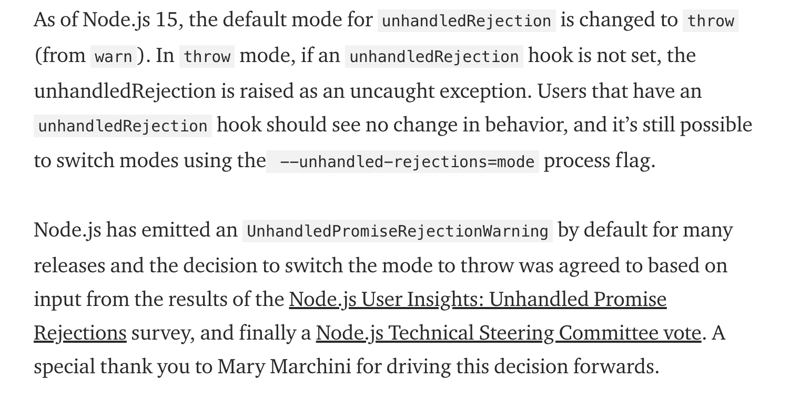
Throw on unhandled rejections

Slide 23
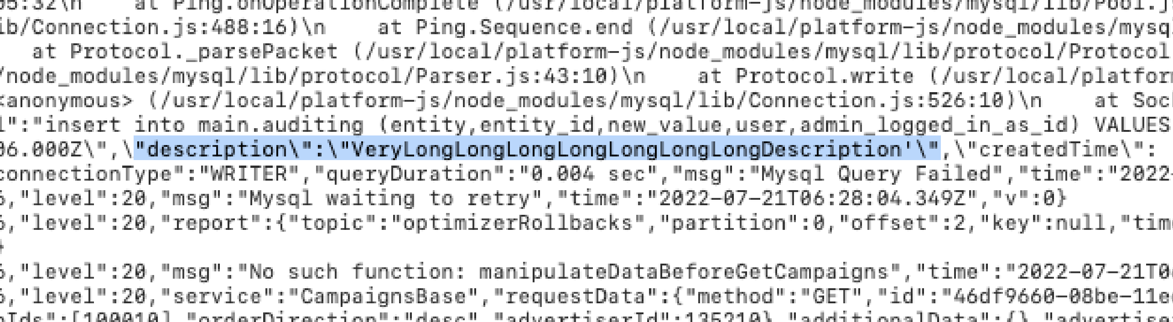
Throw on unhandled rejections

Slide 24
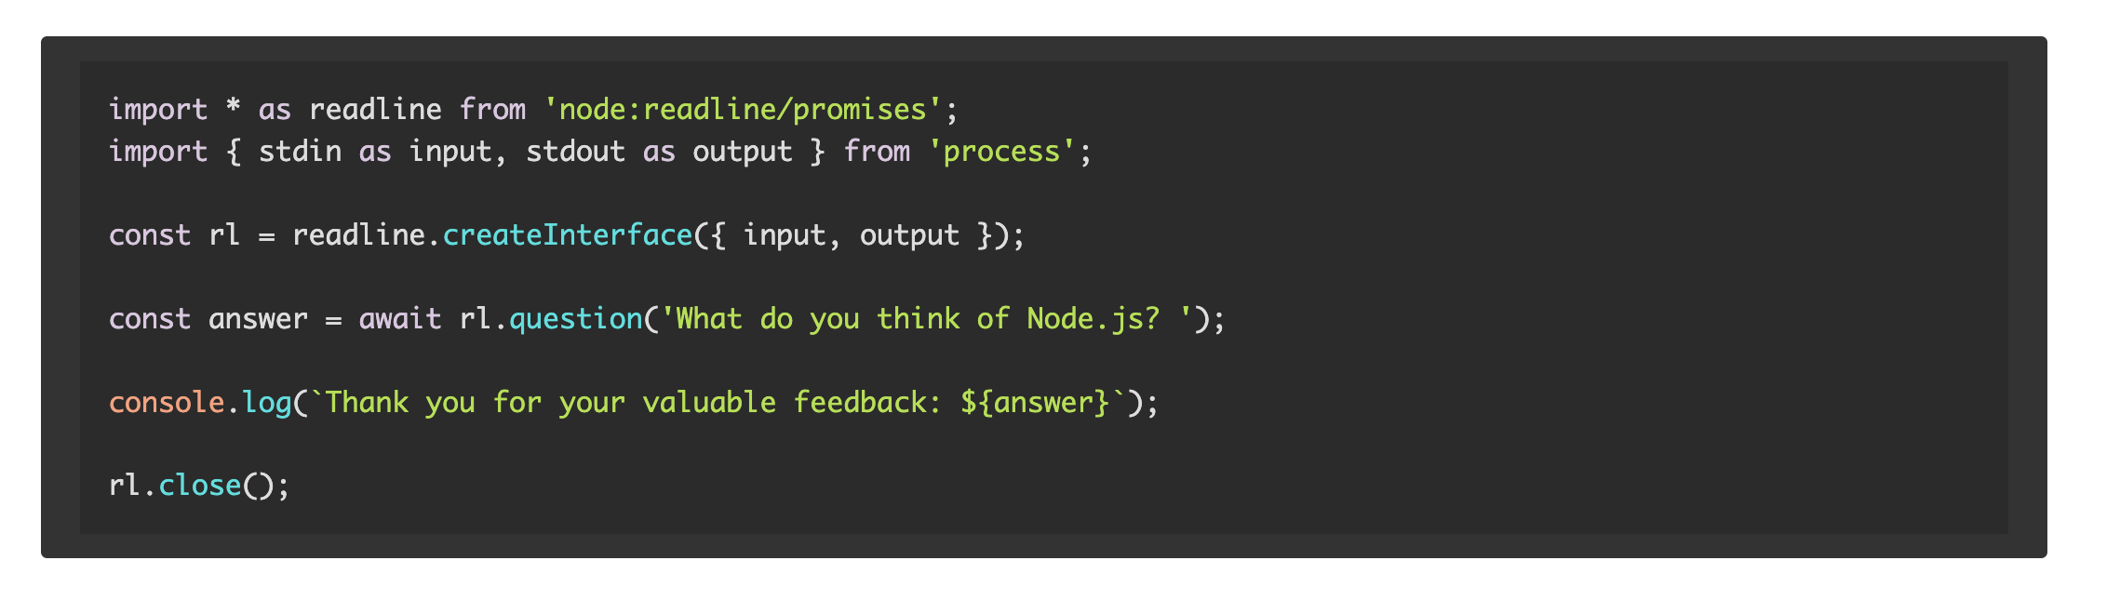
Feature: CLI read write promise interface

Slide 25
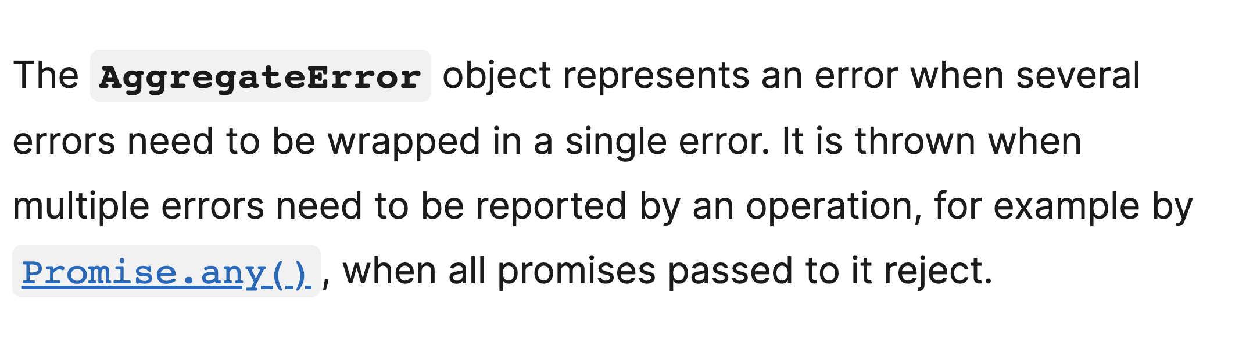
AggregateError

Slide 26
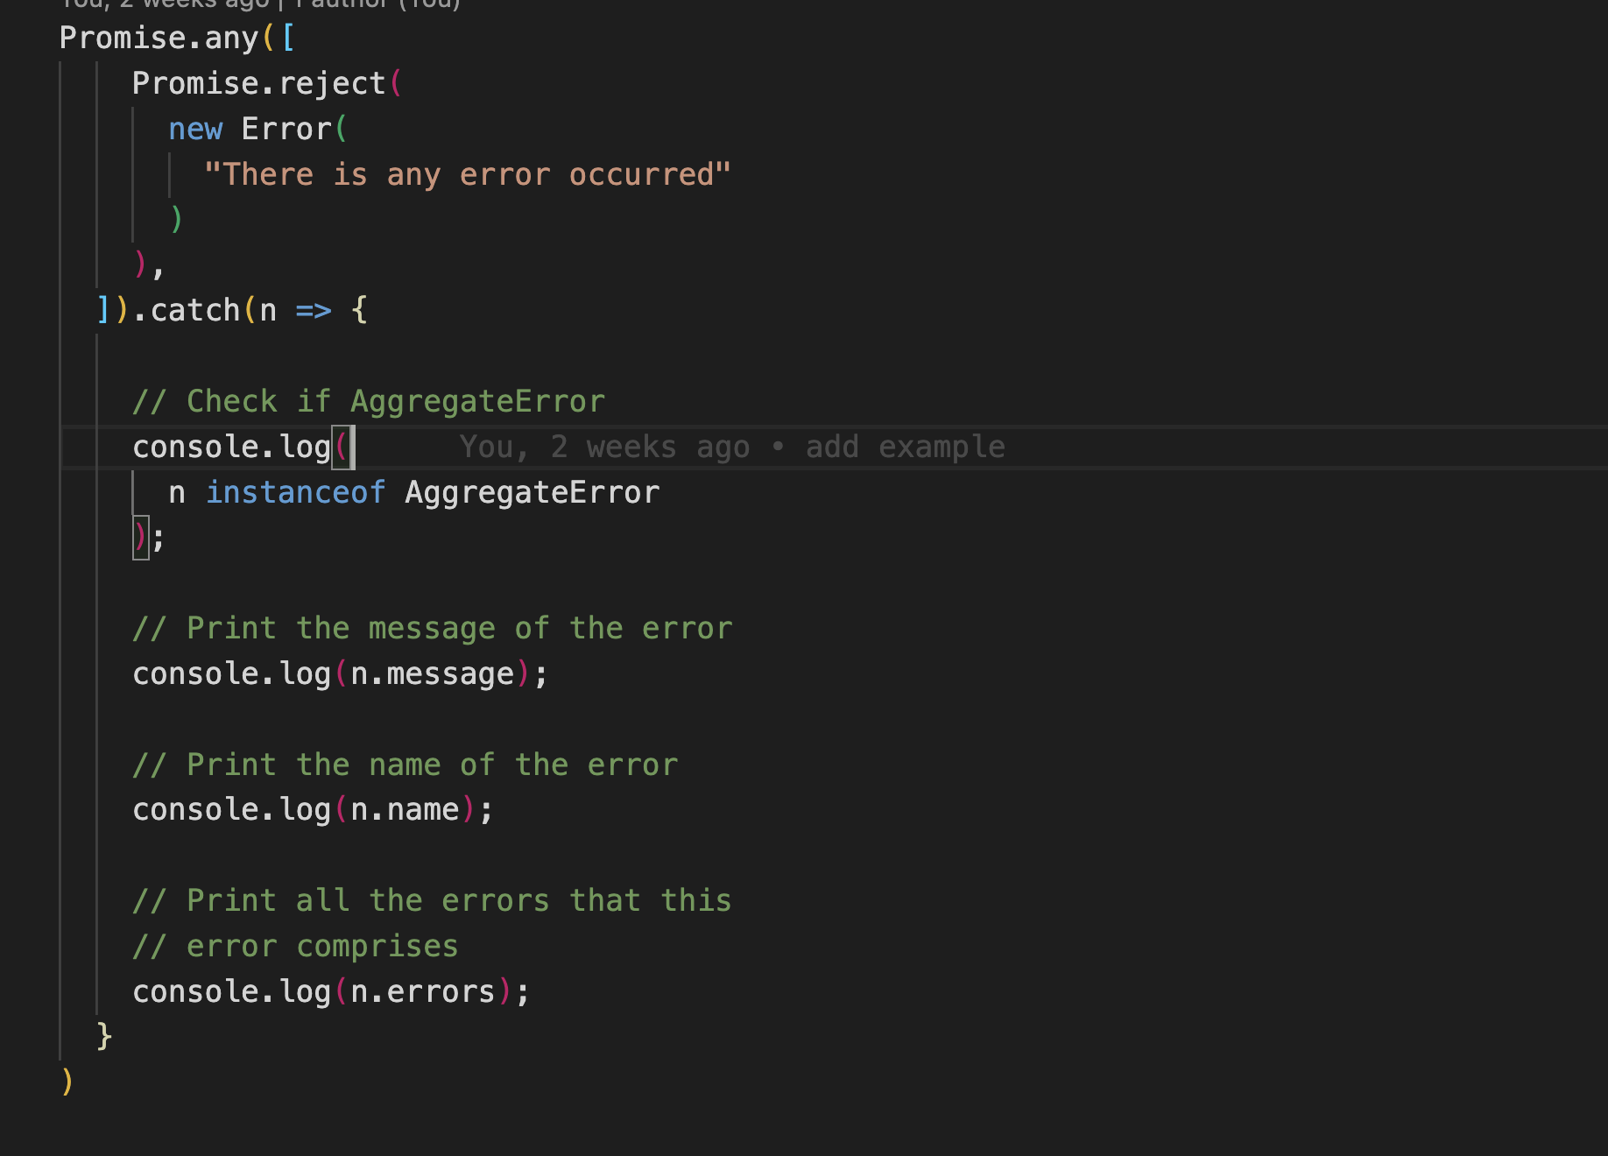
AggregateError

Slide 27
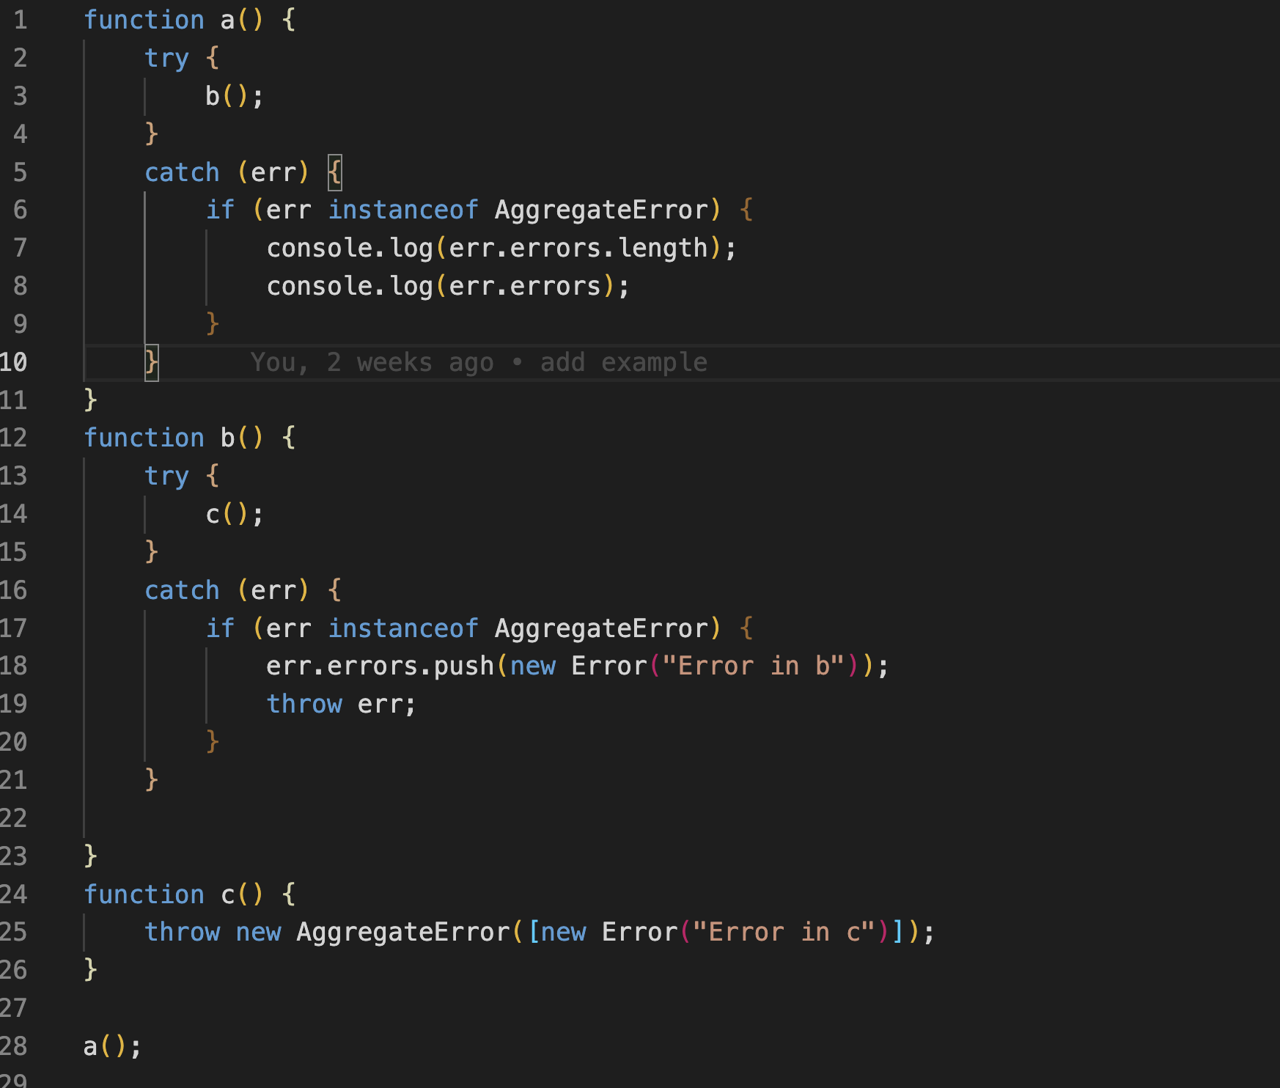
AggregateError

Slide 28
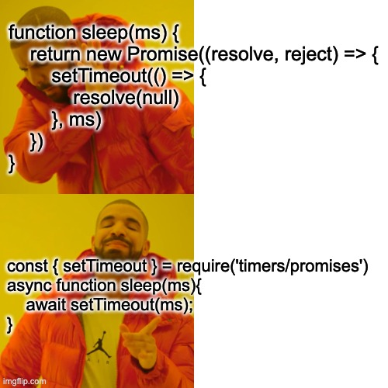
const { setTimeout } = require('timers/promises')

Slide 29
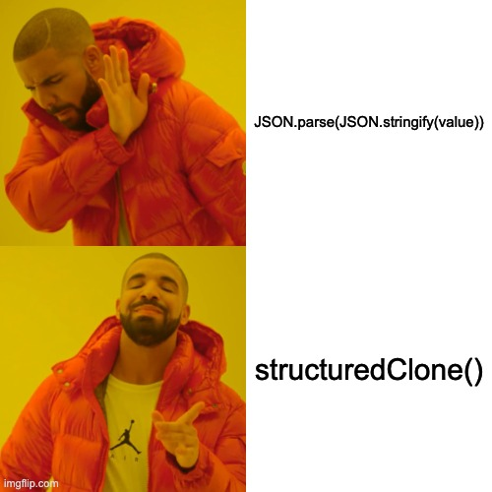
deep clone a value (17.0.0)

Slide 30
deep clone a value (17.0.0)
const obj = {id: 'e1fd960b', values: ['a', 'b']}; const clone1 = {...obj};

Slide 31
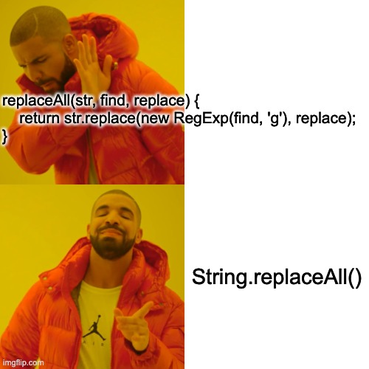
String.prototype.replaceAll()

Slide 32
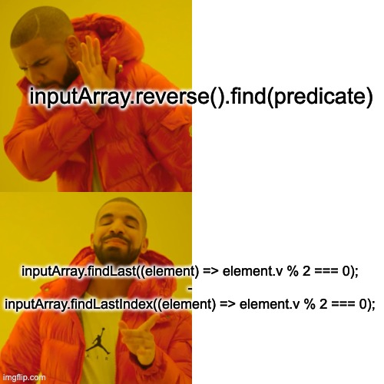
Finding elements from the end

Slide 33
Not coveerd But worth reading
Web Streams API (experimental) BroadcastChannel (worker threads) new operators &&=, ||=, ??=
https://betterprogramming.pub/whats-new-in-node-js-15-fc24e87e2590
https://betterprogramming.pub/a-quick-look-at-the-node-js-16-features-d616e8b2f29
https://betterprogramming.pub/3-major-features-of-node-js-17-4bee7135df02
https://betterprogramming.pub/5-major-features-of-node-js-18-5f4a164cc9fc

Slide 34
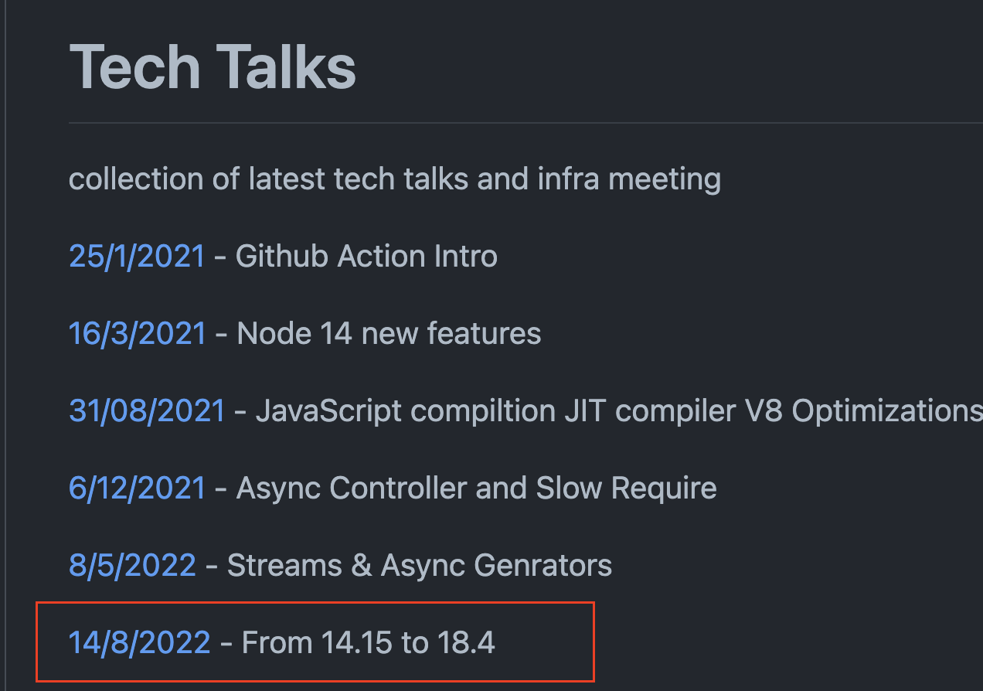
Happy Coding ..
https://github.com/ntedgi/Demand-TechTalks

Slide 35
Happy Coding ..
https://github.com/ntedgi/Demand-TechTalks

